Slide 1

Operating Systems
Lecture 32
Syed Mansoor Sarwar

Slide 2
Agenda for Today
Review of previous lecture
MVT
Paging
Addressing and logical to physical address translation
Page table implementation
Recap of lecture

Slide 3
Review of Lecture 31
Dynamic linking
Overlays
Swapping
Contiguous storage allocation
MFT

Slide 4
MVT
Multiprogramming with variable tasks (MFT)
Both the number and size of partitions change with time
A process still resides in one region but can be of any size up to the size of the user space and can change with time.

Slide 5
MVT
Jobs can move from one partition to another
Dynamic address binding
No internal fragmentation
Introduces external fragmentation

Slide 6
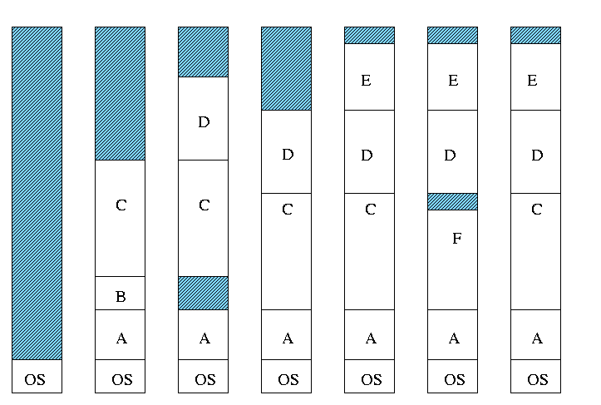
MVT
_{50K}
_{200K}

Slide 7
External Fragmentation
External Fragmentation refers to the state of memory space when total amount of unused memory space exists to satisfy a request but this memory space is not contiguous.

Slide 8
External Fragmentation
Compact main memory (shuffle processes around to put free space in one contiguous area)
Slows down execution of currently running processes

Slide 9
Paging
Divide physical memory into fixed-sized blocks, called frames
Divide logical memory into blocks of the same size, called pages
Size of a page is a power of 2
Typical page sizes: 1K – 16K

Slide 10
Paging
Keep track of all free frames.
To run a program of size n pages, find n free frames and load program pages into these frames.
Keep track of a program’s pages in the main memory by using the page table.

Slide 11
Paging
0
1
2
…
9
10
…
15
0
1
2
3
4
5
6
7
_{Process Address Space}
_{Physical Address Space}

Slide 12
Paging
0
1
2
…
9
10
…
15
0
1
2
3
4
5
6
7
_{Page}
0
1
2
3
…
7
3
9
11
…
1
_{Page Table}
_{Process Address Space}
_{Physical Address Space}

Slide 13
Paging
0
1
2
…
9
10
…
15
0
1
2
3
4
5
6
7
0
1
2
3
…
7
9
…
_{Page Table}
_{Process Address Space}
_{Physical Address Space}

Slide 14
Paging
Logical address space of a process can be noncontiguous; a process page is allocated a frame whenever the latter is available.
Set up a page table to translate logical addresses to physical addresses.
Internal fragmentation

Slide 15
Addressing in Paging
Logical address: (p, d)
where, p is page number and d is offset within the page
p is used to index the process page table; page table entry contains the frame number, f, where page p is loaded

Slide 16
Addressing in Paging
Physical address of the location referenced by (p,d) is computed by appending d at the end of f, as shown below:
f | d

Slide 17

Address Translation
_{f}

Slide 18

Addressing Example

Slide 19

Paging Example
Page size = 4 bytes
Process address space = 4 pages
Physical address space = 8 frames
Logical address: (1,3)
= 0111
Physical address: (6,3)
= 11011
₀
_{Page}
_{Frame}
₁
₀₁₁₁
₂
₃
₁₁₀₁₁

Slide 20
Addressing in Paging
Logical address space of 16 pages of 1024 words each, mapped into a physical memory of 32 frames.
Logical address size?
Physical address size?
Number of bits for p, f, and d?

Slide 21
Recap of Lecture
MVT
Paging
Logical and physical addresses
Address translation

Slide 22
Operating Systems
Lecture 32
Syed Mansoor Sarwar

